Slide 1
260527 Meeting
Dylan Junluo CHEN
Supervisor: Ben LIU & Xin LI

Slide 2
Outline
围绕competition逻辑的两个故事(contribution和innovation)，寻找可行的交互结果
李老师敲定了最终选择的结果
我绘制了交互效应的图，但是置信区间有一些问题

Slide 3
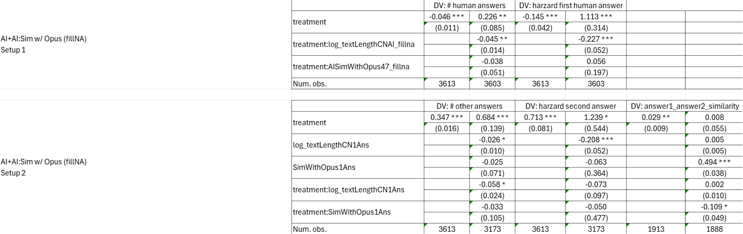
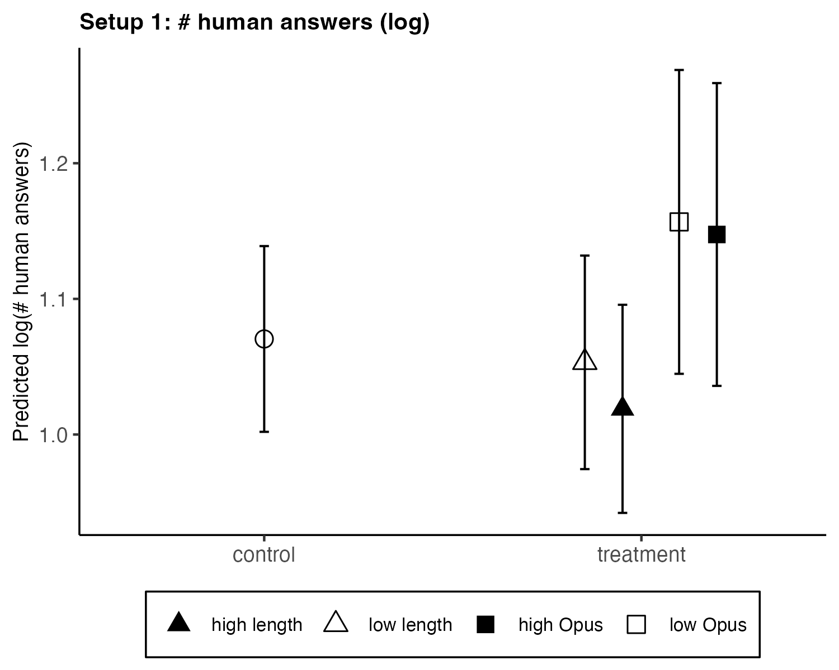
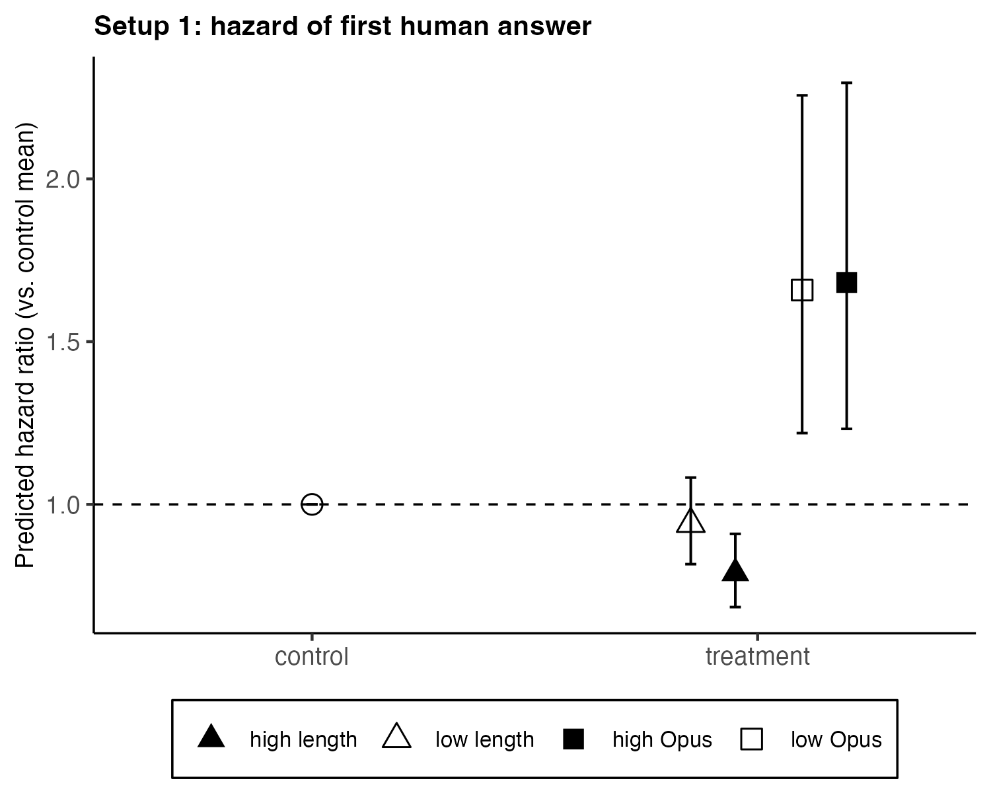
Selected results & plot

Slide 4
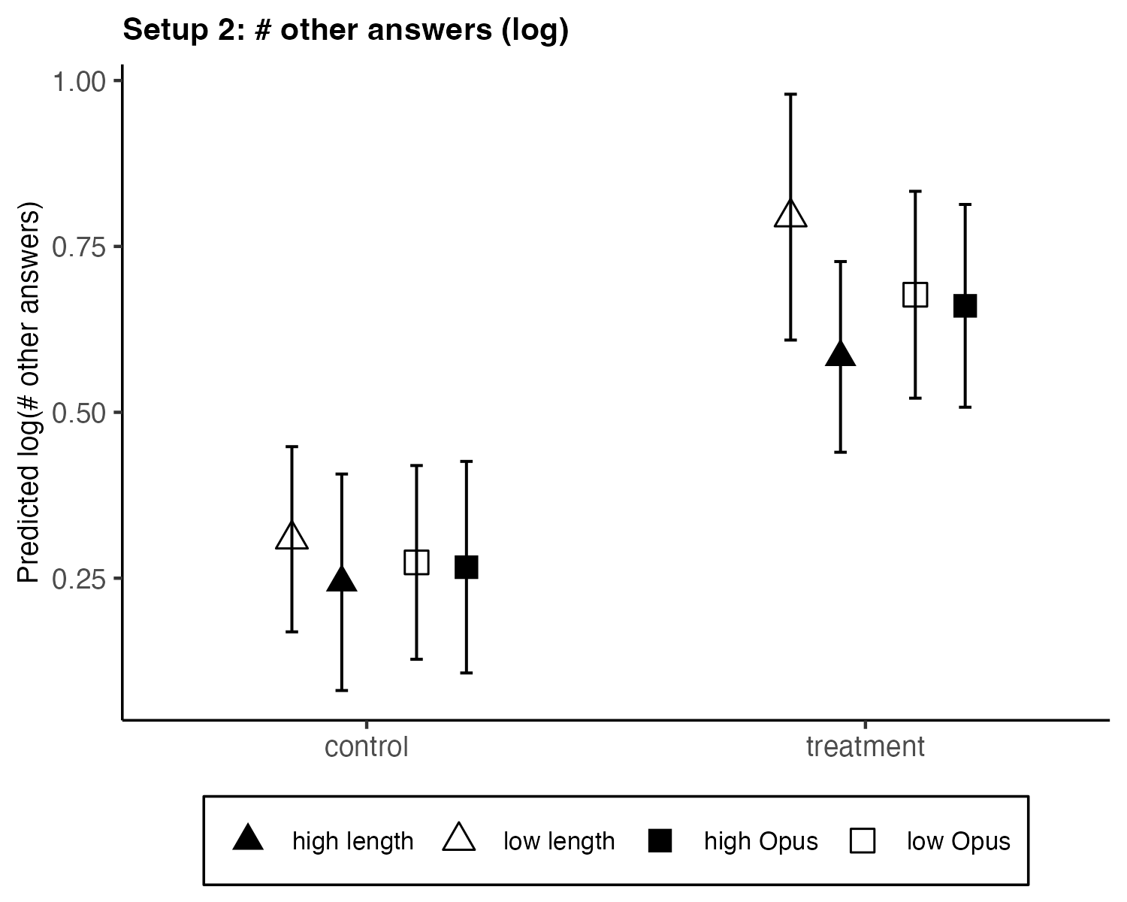
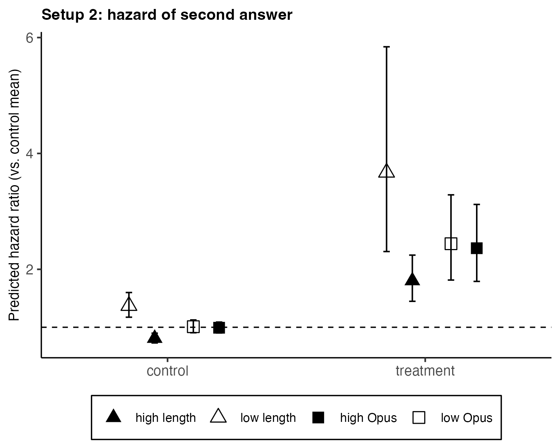
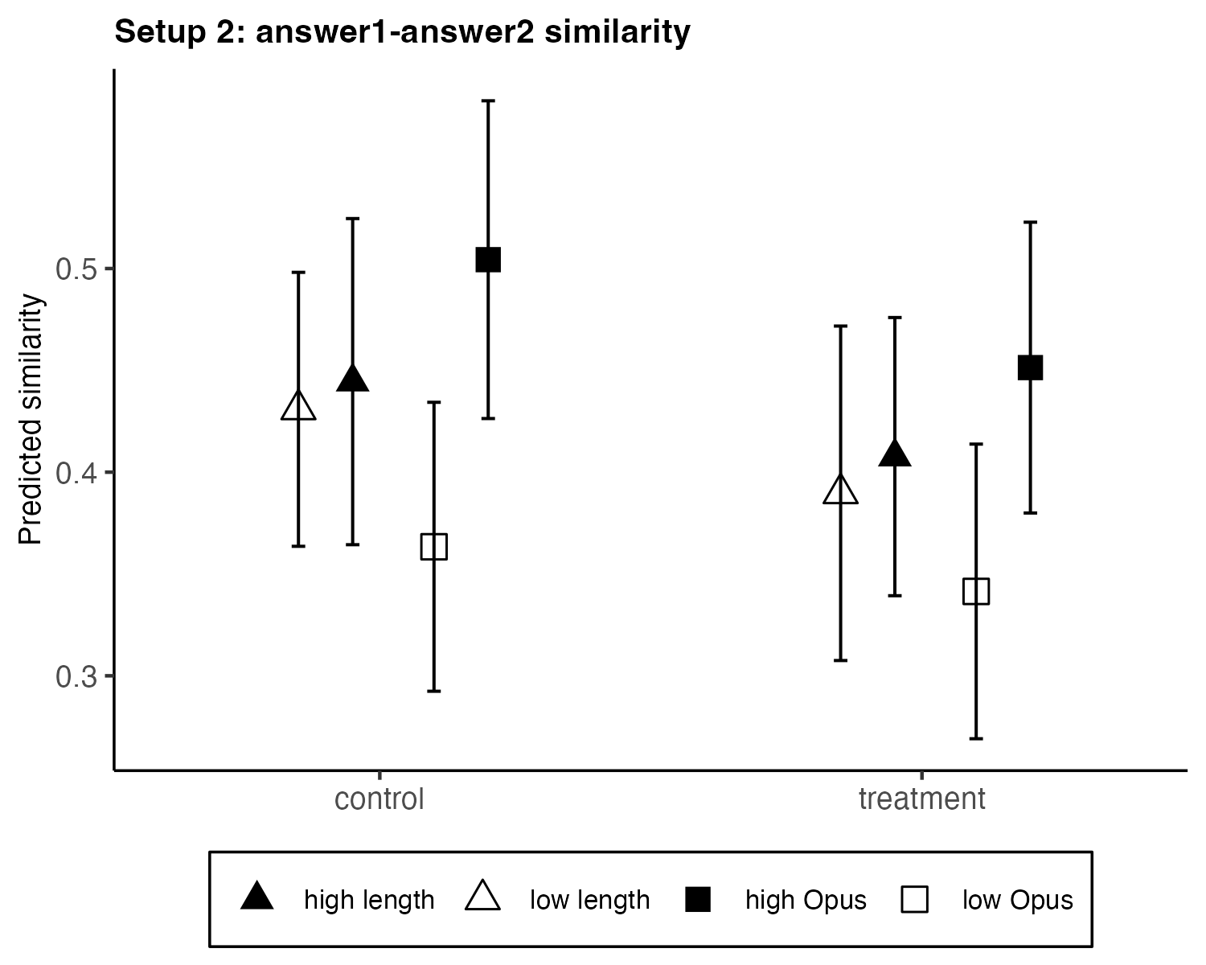
Selected results & plot

Slide 5
Opus + Deepseek results

Slide 6
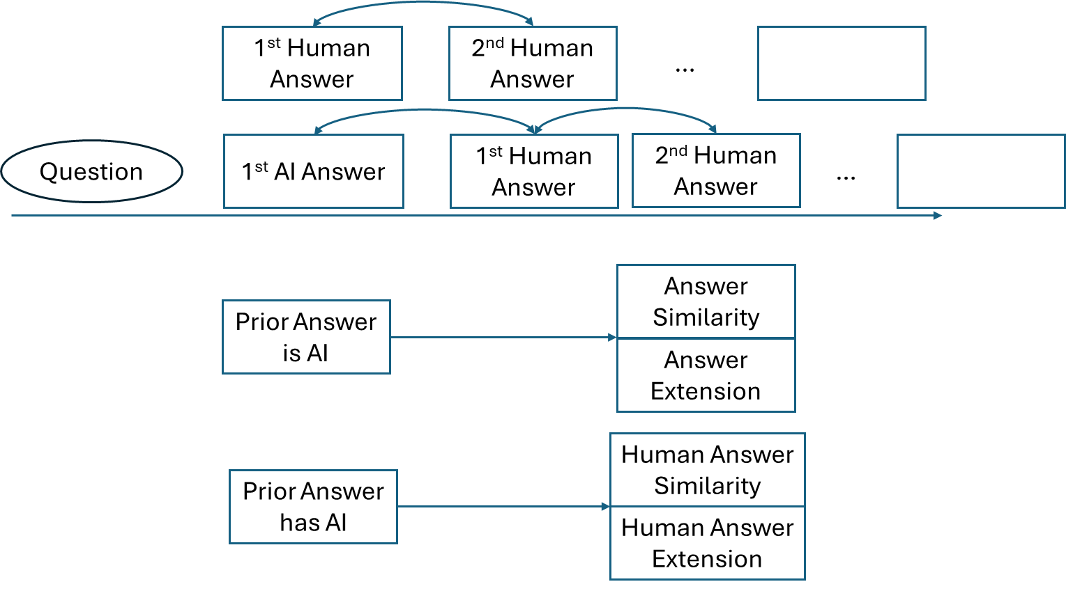
✅
Outline
✅
competition logic results
AI → answerNum & timeliness
AI → innovation
"前一个是 AI" vs "前一个是 Human"
AI 在场如何影响 Human2 vs Human1
✅
✅
DV: 2ndAnsInnovation
IV: firstAnsSimWithAccept
Sample: only second answer
Alternative become Column 1

